Slide 1


Y11 Parent Support Session
Friday 23rd February 2023
Strong in Action, Gentle in Manner

Slide 2

40 school days until
students first written GCSE exam!!!
Strong in Action, Gentle in Manner

Slide 3
What will we do to support your daughter in the next 40 days and beyond, to ensure they achieve the BEST grades possible this summer???
Strong in Action, Gentle in Manner

Slide 4
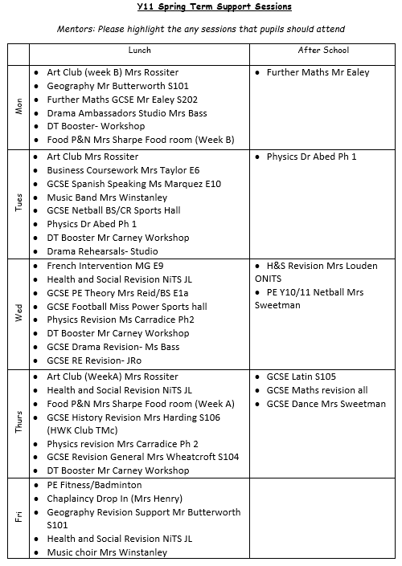


REVISION CLASSES
There are revision sessions of some form on EVERY DAY
Some subjects plan to put on Revision sessions during the Easter holidays and/ or May half term
Parents will be able to see via Classcharts which revision sessions your daughter has attended each day.

Slide 5



STUDY SPACE
Y11 have been given PRIORITY access to A3 ICT room each Mon, Weds and Fri lunchtime
Y11 now have sole access to the library for supervised study after school each Mon, Tues, Thurs & Fri up until Easter and EVERY day after Easter through to the end of exams

Slide 6

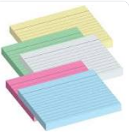

STUDY PACKS
Study packs containing highlighters, flash cards, post its, basic exam equipment can be made available to those who make effective use of study sessions

Slide 7


Additional
Some students have been assigned a ‘mentor’ who will meet with them regularly to support with study plans, time management, revision techniques
Some students will meet regularly with a designated member of SLT to set weekly study targets, monitor attendance and discuss progress in key subjects.
Some targeted students will be withdrawn from general PE lessons to attend subject specific intervention sessions or study support sessions. Parents will be consulted on this.
Targeted one to one/small group tuition continues after school each Wednesday for some students

Slide 8
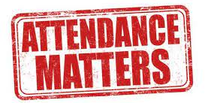
Attendance
Attendance at ALL lessons is crucial!
Any student who has attendance below the Government’s expectation of 95% and is not achieving in line with target grades will be monitored carefully either through their assigned ‘mentor’, designated SLT, or a member of the Y11 Pastoral support team.
Attendance notifications will be sent out to parents each week to inform of absences.
Students will be expected to make up any work missed and provide evidence that work has been completed.
All students with 100% attendance the previous week will be entered into a prize draw and one name selected in assembly each week to win a £10 Liverpool ONE voucher.

Slide 9



Core Subject Focus in Form Time & PSHE
As of Tues 20th Feb, form time each morning will be used to complete additional tasks which will focus on key knowledge and exam techniques in the Core Subjects; your grades in these subjects are crucial to keep all Post 16 pathways open to you!
PSHE time will also be used this half term to focus on ‘Recall and Retention’, ‘Exam Practice’ and ‘Exam Techniques’ in the Core Subject Areas
This will mean a temporary change to the Y11 Pastoral Team

Slide 10
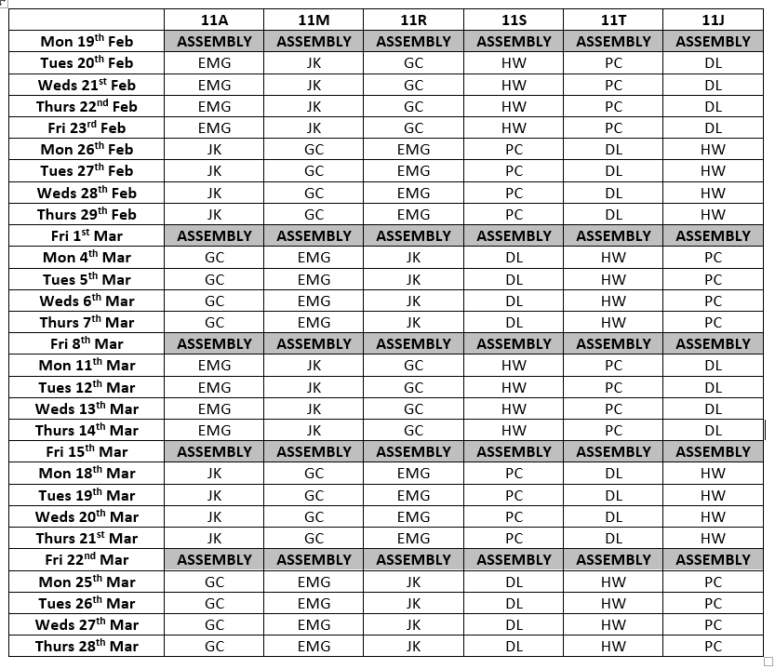
Core Subject Focus in Form Time & PSHE
Each week you will have an English, Maths or Science specialist taking am registration time and PSHE.
There will be a rota so that each form focuses on a different Core Subject each week
11AMR:
Miss McGinn
Mr Kinsella
Mrs Carradice
11STJ:
Ms Whitehead
Mr Coupe
Mr Lawson

Slide 11
Core Subject Focus Additional Mock Exams
Towards the end of this half term, we will provide another opportunity to sit a further mock exam in English Literature and Maths to identify where progress has been made and to highlight any topic areas that still need addressing.
  Thursday 14th March – English Paper 1, 2.5hrs
  Monday 18th March - Maths Paper 1, (1.5hrs- non calc)
  Wednesday 20th March – Maths Paper 2 (1.5hrs- calc)
  (TBC Thursday 21st March – English Paper 2, 2.5hrs)
More details to follow in the forthcoming weeks!

Slide 12


Rewards
Many of students have already received handwritten praise postcards in the post
at the end of last half term. Staff will continue to send positive praise postcards home to recognise efforts and progress in Y11 in particular over the forthcoming weeks.
Weekly attendance draw for a £10 Liverpool ONE voucher as previously mentioned; all students with 100% attendance the previous week will be entered for the draw.
Weekly Head of School Award – each week staff will be asked to nominate a Y11 student for the Head of School Award. A winner will be selected at random to receive a £10 Liverpool ONE voucher. All parents/carers of all nominees will be notified via email each Friday afternoon.
Y11 Subject/Study Recognition awards – each week, every subject area will be asked to nominate a Y11 student to be invited to join the 6th Form and SLT in a ‘reward breakfast’ at Friday break time. Students will receive a free tea/coffee and croissant in recognition of their hard work/commitment to study/perseverance and resilience.

Slide 13


What will students do in the next 40 days and beyond, to ensure THEY achieve the BEST grades possible this summer???

Slide 14

Y11 - 4 STEPS to

Slide 15
WE ARE ENCOURAGING THE STUDENTS TO
C
A
R
E
about their grades
about their future
about their friends & classmates
about the impact that THEIR actions and behaviour have on the learning of others
and know that staff at Bellerive CARE about THEM!

Slide 16
C
A
R
E
‘CAN DO’ attitude
ATTEND
REVISE
ENGAGE

Slide 17
‘CAN DO’ Attitude

Slide 18


Approach everything with a ‘Can do’ attitude
BELIEVE that the next 40 school days CAN make a difference to grades, whether it is turning grade 7’s into 8’s, 5’s into 6’s, 3’s into 4’s or otherwise, students CAN make a difference to their grades this summer if they make the most effective use of the next 40 school days!
Approach EVERY task and EVERY learning opportunity with a ‘CAN DO’ attitude; do NOT be defeated when they find things difficult! Seek help, seek clarification, seek support!

Slide 19
ATTEND

Slide 20
Attend to ACHIEVE
Y11 Attendance is currently 88.9%
which is BELOW the National average for Y11 students
EVERY 6th form/college/job application will want to know YOUR attendance!
Would you give a job or college placement to someone with attendance of 88.9% and is therefore absent at least HALF a day EVERY week?
If students only have 90% attendance between now and the first exam you will miss 22.5 hours of learning – that’s almost a full week’s worth of lessons to try to make up whilst also keeping on top of ‘new learning’!
ATTEND EVERY SINGLE LESSON!

Slide 21
REVISE

Slide 22

Students should have started their Revision ALREADY!!! They should
Attend lunch time and after school revision sessions as often as possible
Use the ICT room at lunchtime and the library after school as a quiet place to study
Plan their study time (& social time) inside and outside of school. Produce a weekly study plan; set achievable targets
Prioritise the topic areas they know they need to improve in

Slide 23
ENGAGE

Slide 24
ENGAGE in Learning
Engage in lessons!
Engage in revision/support sessions!
Be on time – every minute counts! Students arriving late to lessons impacts others learning!
Follow instructions – behave appropriately and complete tasks set to the BEST of their ability
Seek help and support from their teachers where needed

Slide 25
C
A
R
E
‘CAN DO’ attitude
ATTEND
REVISE
ENGAGE

Slide 26
40 school days until
the first written GCSE exam!!!
Strong in Action, Gentle in Manner

Slide 27
Exam Timetables
Provisional exam timetables will be distributed by the end of next week.
Students and parents are to check these carefully
Please raise any queries regarding particular subjects with the Head of Department, more general enquiries can be directed to the office FAO Mrs M Walker, Exams Officer.
First written exam- RE Written Paper 9th of May
Official last day, Friday 28th June (Dates of leaver’s assembly TBC)

Slide 28
Mental Health Support
Young Minds: Exam Stress
Students; Managing your mental health during exams
Parents; Supporting your child during exams
Kooth- online counselling service
CAMHS
Merseyside Youth Association
NSPCC
Childline
ypas.org.uk/what-we-do/well-being-services/crisis-drop-in/

Slide 29


Slide 30
Some Important Dates
First written exam 9th of May (RE paper)
Official last day, Friday 28th June (Leaver’s assembly that week)
Step into Sixth Form week Monday 1st July
Y11 End of Y11 Celebration Evening (Prom) Thursday 4th of July
GCSE Results Day Thursday 22nd August

