Slide 1
Welcome to the Year 9 Pathways presentation
The next phase of your daughter’s educational journey at Bellerive
Year 10 and Year 11
2025-2027

Slide 2
Our aims this evening
To provide you with a comprehensive overview of the pathways process
To explain the specifics of the science offer and how it relates to the pathways process
To answer any immediate questions you or your daughter might have
To outline the next steps in the pathways process

Slide 3
What will Y10 and Y11 look like for your daughter?
All students study:
  English GCSE
  English Literature GCSE
  Maths GCSE
  Science: Combined Science ( Trilogy) worth 2 GCSEs or Separate Sciences worth 3 GCSEs
  RE (GCSE)
  PE and PHSE (non-exam subjects)

Slide 4
The core curriculum
These compulsory subjects take up about 75% of the timetable
We believe students should study these subjects because they provide vital skills to help them access the sixth form, employment, training and the most competitive universities
It is also the case that some of them are statutory

Slide 5
GCSE assessment
All GCSE subjects will be graded 9-1 in 2027
BTEC and other GCSE equivalent subjects will continue to have their own grading system ( Pass, Merit, Distinction, Distinction *)
For parents/carers, this grading system will be very different than the one you experienced from your own school days

Slide 6
Changes to GCSE assessment
Grade 9: top A* performers; about half of the 6.8 per cent who got A*s are likely to get it
Grade 8: the rest of those who obtained A* but did not qualify for a 9
Grade 7: equivalent to an A grade pass
Grade 6: covering those from two thirds above current C grade to top of existing B grade
Grade 5: international benchmark, showing performance equals that of students getting top-grade passes in high performing countries in international league tables. Pitched at half or two thirds of a grade above the current C pass
Grade 4: equivalent to a C grade pass
Grade 3: equivalent to a D grade pass
Grade 2: equivalent to an E grade pass
Grade 1: equivalent to grade F and G passes

Slide 7
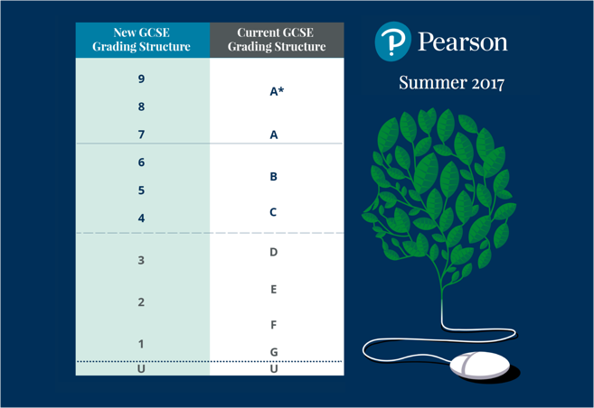

Slide 8
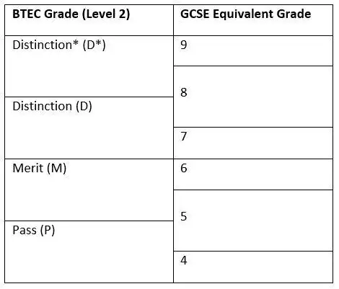

Slide 9
Sciences at Key Stage 4
Route 1 – Separate Sciences
Route 2 – Combined (Trilogy)
Three separate GCSE qualifications in Biology, Chemistry and Physics
Best suited to those in sets 1 and 2
Helpful but not essential for progression on to A Level Science courses
More demanding than Trilogy as more content and longer exams
Students should be targeting 7+
Biology, Chemistry and Physics papers are combined to produce a result worth two qualifications. i.e. 6-6 or 7-6
Shorter papers and less content to learn than separate sciences
The majority of pupils in the country take this course
Good grades (9-6) will allow progression onto A’ Levels in Sciences
Please note: Top universities are looking for the quality of grades at GCSE (9/8/7) NOT the quantity of GCSEs taken.

Slide 10
Which Science route is best for me?
Think about your current teaching group
Think about your current progress in science
Think about your interest in science
Think about your interests in other subjects: remember that Separate Sciences are an option
Experience tells us that pupils in sets 1 and 2 perform best in separate sciences
Those not in sets 1 and 2 tend to get a better grade with Combined Science as opposed to Separate Sciences
Grade quality is more important than grade quantity

Slide 11
Routes in Science
Science
Route 1
Route 2
Separate Science
Combined Science
Biology, Chemistry and Physics
Biology
Chemistry
Physics

Slide 12
Sciences at Key Stage 4
The Science Department is providing guidance on which KS4 Sciences course we feel is the most appropriate for your daughter.
Please feel free to discuss the KS4 Sciences routes with the heads of each department:
Dr E Abed(Head of Science Faculty/Head of Physics)
Mr. A. McBurney (Head of Biology)
Mr. P. Coupe (Head of Chemistry)
If you are considering studying Sciences at a top university in the future a useful resource is ‘Informed choices’ A Russell Group guide to making decisions about post-16 education 2016. (Page 22-25 - Pre-16 qualifications and university entry)
http://www.russellgroup.ac.uk/media/informed-choices/InformedChoices-latest.pdf

Slide 13
Option subjects
Students will choose up to 3 option subjects
This makes up around 25% of their timetable
Our view is that students are better served with higher grades in 8-9 GCSE subjects rather than lower grades in 10 or more GCSE subjects
Universities are interested in the quality of the grade as opposed to the quantity of grades
We have increased the amount of time for the options over the course of Y10 and Y11 to reflect the greater challenge with the current GCSE specifications
We have been working with students on choices in the PHSE programme and in assembly

Slide 14
Option choices
We will be speaking to students individually about their option choices
We strongly believe in the need for students to follow a balanced curriculum. This balanced approach helps keep options at 16+ open to students
Studying a language and a humanities subject provides balance and a strong academic core
There are also a range of creative subjects to consider
Ultimately, the decisions will be made in partnership: students, parents and school working together

Slide 15
GCSE subjects and future university applications
Universities may ask for a specific number of GCSEs (or their equivalent). For example, medical courses usually ask for five grade 9/8s (A*s and As), sometimes more.
Many universities have a universal requirement for grade 5/4 (C) (or equivalent) in GCSE English and maths
There is no universal entry requirement for students to have studied a modern foreign language at GCSE or equivalent. Check whether there are any course-specific requirements.
For a degree in English, some universities see it as an advantage applicants to have a GCSE in a modern or classical language
Applicants to study medicine, dentistry and veterinary science are usually required to have very good results in maths, science and English.
Applicants for teacher training courses need a minimum of grade 5/4 (C) in maths, sciences and English. Some universities may ask for a minimum grade 6 (B).
For a business or economics degree, sometimes a grade 7 (A), more often at least a grade 6 (B), in GCSE maths is required.
A grade 7/6 (A/B) in maths is often required for a degree in psychology and a grade 6 (B) in a science may also be required.
To study a science subject at university (including biology, chemistry and physics), applicants will usually need to have achieved a minimum grade 5/4 (C) in maths at GCSE if they are not taking it at advanced level
If you are interested in a specific degree course, please check the university admission requirements and this will confirm if specific GCSE grades/subjects are required
https://www.informedchoices.ac.uk (Russell Group universities)

Slide 16
How should pupils choose their options?
DO | DON’T
Think about subjects you enjoy | Think about what your friends are doing
Think about subjects you are good at | Think some subjects are ‘easier’ than others
Think about how the subject is assessed | Think about choosing a subject because it ‘sounds good’
Think about the advice of your teachers | Think about choosing the subject because you like your current teacher
Think about the skills you will develop | Think about choosing a subject because you can’t think of anything else

Slide 17
Making good option choices
All GCSE/BTEC courses last for the entirety of Y10/11
Pupils will be given an opportunity to request an option change before the end of Y9 and then in the first 2-3 weeks of Y10
From this point in Y10 ( late September), it is not possible to change option subjects except in exceptional circumstances
Pupils are expected to continue with the full curriculum until the end of Y11
There will be occasions where progress might cause concern and pupils feel they cannot manage to continue with a subject
However, this should not mean an immediate desire to 'drop' subjects. These requests are rarely considered and only in very exceptional circumstances
Support from their teachers will be ongoing and we are determined that pupils will display resilience in such circumstances

Slide 18
What happens next?
We would like students to complete the option form by Monday 10th March 2025. This form will be sent to students by the end of this week
Write 1 for the first choice and 2 for the second choice in each column
When deciding if an option subject will run , we will factor in the number of students opting for the subject
Where more students opt for a subject than we can accommodate, we will take factors such as behaviour into account
There may be some ‘clashes’: subjects which you want to study that appear in the same option block. This does not happen all that often and we will try our best to resolve the issue
Please make sure you are comfortable with both subjects in all option columns
Students will be informed of their final option choices in the summer term

Slide 19
What happens next?
Visit the subjects and ask questions
Talk to your teachers
Options forms will be released before end of this week in time for half-term reflection
I am available in school to discuss further
options@bellerivefcj.org: this email address will be checked daily until options deadline day

