Slide 1


Year of prayer 2024

Slide 2
Year of prayer
2024 is a special year of prayer
The focus is on The Our Father Prayer
It can be found in Luke’s Gospel (Luke 11: 2-4)
Jesus taught his disciples to pray to God with this prayer
It is a prayer all Christians can use to pray alone or together

Slide 3

Our Father, who art in heaven,
hallowed be Thy name;
Thy kingdom come;
Thy will be done on earth as it is in heaven.
Give us this day our daily bread; and forgive us our trespasses as we forgive those who trespass against us;
and lead us not into temptation,
but deliver us from evil.

Slide 4

You Tube Link to the Our Father in different languages:
https://www.youtube.com/watch?v=aDcwX_3DIJw
You Tube Link to the Our Father in BSL:
https://www.youtube.com/watch?v=WrpjmrtF7Z0
You Tube Link to the Our Father in song (CJM Music):
https://www.youtube.com/watch?v=9tGqHrR8J0U

Slide 5
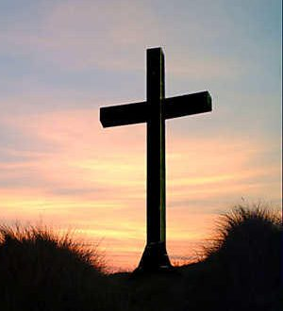
Our Father in Spanish
Padre nuestro,
que estás en el cielo.
Santificado sea tu nombre.
Venga tu reino.
Hágase tu voluntad en la tierra como en el cielo.
Danos hoy nuestro pan de cada día.
Perdona nuestras ofensas,
como también nosotros perdonamos a los que nos ofenden.
No nos dejes caer en tentación y líbranos del mal.

Slide 6
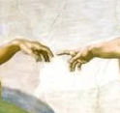
Our Father in French
Notre Père, qui es aux cieux, Que ton nom soit sanctifié, Que ton règne vienne, Que ta volonté soit faite sur la terre comme au ciel. Donne-nous aujourd'hui notre pain de ce jour. Pardonne-nous nos offences Comme nous pardonnons aussi à ceux qui nous ont offensés. Et ne nous soumets pas à la tentation, mais délivre-nous du mal, car c'est à toi qu'appartiennent le règne, la puissance et la gloire, aux siècles des siècles.

Slide 7
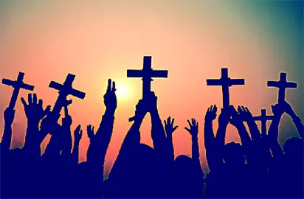
Our Father in Yoruba
Baba wa ti mbẹ li ọrun
Ki a bọwọ fun orukọ rẹ
Ki Ijọba rẹ de
Ifẹ tire ni ki a ṣe
Bi ti orun, beni li aiye
Fun wa li onje Ojo wa loni
Dari gbese wa ji wa
Bi awa ti ndariji awon onigbese wa
Ma si fa wa sinu idewo
Sugbon gba wa lowo bilisi
Nitori ijo ba ni tire
Ati agbara, Ati ogo
Lailai, Amin

Slide 8
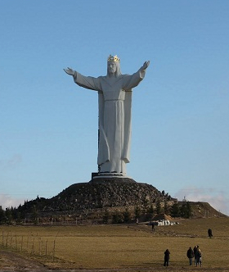
Our Father in Polish
Ojcze Nasz, któryś jest w niebiesiech,
święć się imię twoje;
przyjdż królestwo twoje,
bądż wola twoja,
jako w niebie tak i na ziemi.
Chleba naszego powszedniego daj nam dzisiaj,
i odpuść nam nasze winy,
jako i my odpuszczamy naszym winowajcom.
I nie wódż nas w pokuszenie,
ale nas zbaw ode złego

Slide 9
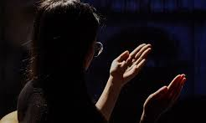
Our Father in Cantonese
我們在天上的父，
願人都尊祢的名為聖，
願祢的國降臨，
願祢的旨意行在地上，
如同行在天上。
我們日用的飲食，今日賜給我們，
免我們的債，如同我們免了人的債，
不叫我們遇見試探，
救我們脫離兇惡，
[因為國度、權柄、榮耀，全是祢的，
直到永遠。阿們！ ]

Slide 10
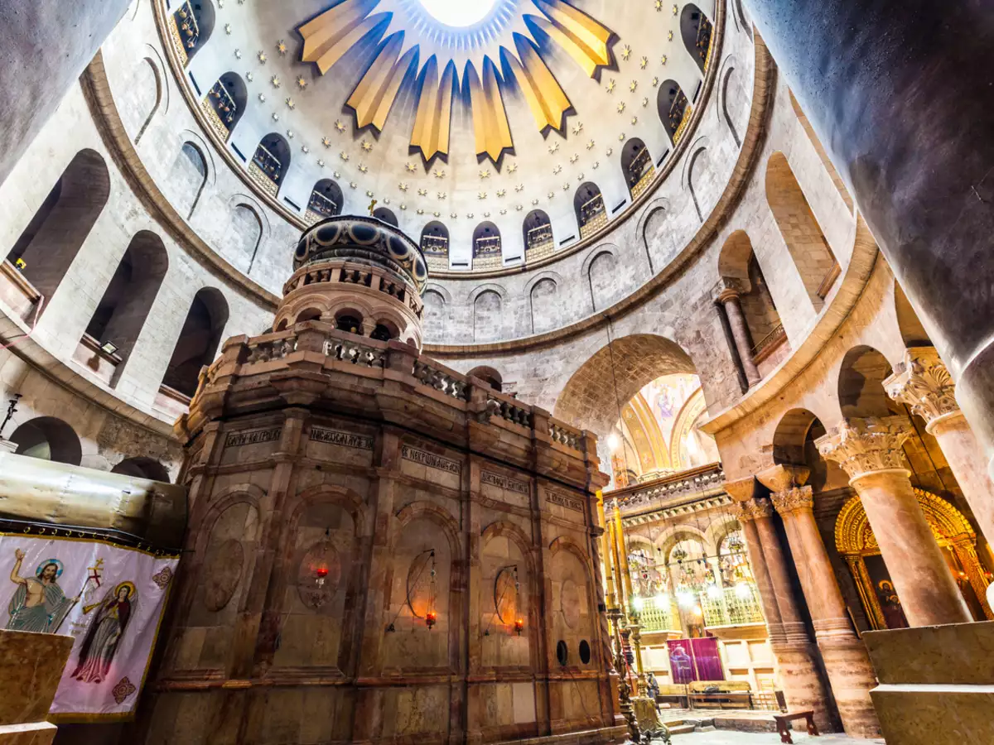
أَبَانَا الذِي فِي السَّمَاوَاتِ، لِيُقَدَّسَ اسْمُكَ. لِيَأْتِ مَلَكُوتُكَ، لِتَكُنْ مَشِيئَتُكَ فِي الأَرْضِ كَمَا السَّمَاءِ. ارْزُقْنَا خُبْزَنَا كَفَافَ يَوْمِنَا، وَ اعْفُ عَنْ خَطَايَانَا، فَإِنَّنَا نَعْفُو عَمَّنْ يُخْطِئُونَ بِحَقِّنَا. لاَ تُعَرِّضْنَا لِلغِوَايَةِ، بَلْ نَجِّنَا مِنَ الشِّرِيرِ. فَلَكَ المَلَكُوتُ وَ الجَبَرُوتُ وَ المَجْدُ أَبَداً.
Our Father inArabic

Slide 11
More Prayer Resources for the Year of Prayer

Slide 12

Prayer for the Year of Prayer
God of blessings,
in this year ahead,
give us a spirit of listening,
of openness to your word
and longing for your kingdom.
As we journey toward the Jubilee,
a time of new beginnings,
we pray for help and strength,
to heal our relationships with each other and all creation.
Sing your song of love over us,
renewing our faith and courage,
so we may join our voices together,
discovering new harmonies of hope,
new melodies of reconciliation
Attentive to the Spirit,
and awake to the needs of the world,
may we seek your life-giving presence, as we join as one global family, in a great symphony of prayer and praise.
Amen.

Slide 13
The Examen
1. Become aware of God’s presence.
2. Review the day with gratitude.
3. Pay attention to your emotions.
4. Choose one feature of the day
and pray from it.
5. Look toward tomorrow.

