Slide 1

Keys to Success
Year 10 Assembly

Slide 2
The Basics for a Fresh Start
🥗 Eating well → regular, nutritious meals, breakfast before school, water, not energy / sugary drinks
😴 Sleeping well → 8 hours a night, phones away one hour before bed
📚 Revising smartly → little & often (20–30 mins), not cramming at midnight, building up to 1-2 hours
🧘 Balance → exercise, spend time outside or nature, hobbies, downtime to recharge, looking after your mental health
Notes:
BEFORE WE BEGIN… this is fundamental and while we’re not all perfect, most of us can do much better at this and we want to be better because the benefits are clear. Begin by adopting these habits at the start of a new term and give yourself the best fresh start possible.

Slide 3




Keys to Success – The Story of Lucy and Mary
Lucy
Mary
Notes:
At the start of Year 10, it is a fresh start from KS3 and Year 9 and it is a new beginning for all of us. And you have a choice to make about what student you are going to be. So, I’m going to tell you a story of two students, who all teachers know. The story of Lucy and Mary, both of who are at a fork in the road. Both have had moments in KS3 where they let themselves down, didn’t try their best or lived up to the high standards that we know they’re capable of achieving.

Slide 4
Meet Lucy
Doomscrolls TikTok instead of revising, leaving her feeling tired and empty
Arrives late, sometimes misses days (‘what’s one day off?’)
‘I’ll start working hard during Year 11’
Doesn’t bring equipment or homework
Has a poor attitude during lesson
Notes:
Lucy has goals — she wants to pass her GCSEs, maybe even go to college — but she doesn’t use the keys to get there and … therefore her door remains shut.

Slide 5

Meet Mary
Arrives on time, ready to learn (‘I’m so glad I didn’t miss today’s lesson’)
Limits screen time
‘If I keep chipping away now, it’ll pay off.’
Revises little and often
Writes homework in journal, meets deadlines
Supports friends, respects teachers
Notes:
Mary has the same goals — but she unlocks the doors to them every day.

Slide 6

Keys in Action
Attitude & Effort
Organisation
Resilience
Companionship
Lucy: “I can’t do this…”
Mary: ‘I can’t do this… yet. I will keep trying until I get it right.’
Lucy: “I can’t be bothered packing my bag.”
Mary: ‘I try to plan my week on a Sunday evening, and use reminders to avoid the stress.’
Lucy: “I got a Grade 2… I’m giving up.’
Mary: ‘I got a Grade 2. I asked my teacher for more detailed feedback and felt better about taking on the next test.’
Lucy: sometimes laughs at others’ mistakes, talks back to staff.
Mary: encourages friends, helps others in class, polite to staff
Notes:
These are your keys to success.

Slide 7
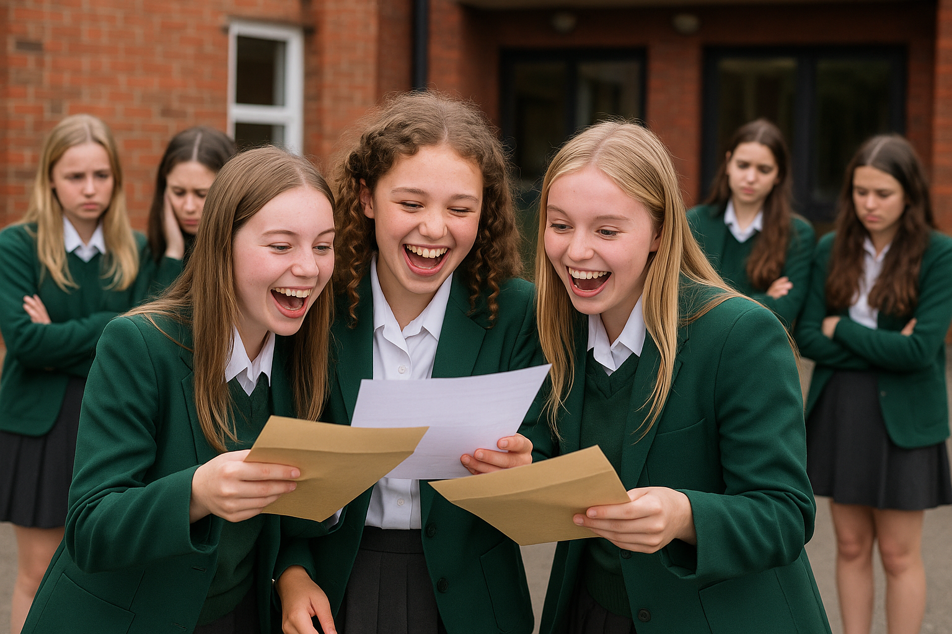
Results Day 2027!
Marys
Lucys
Lucys
Notes:
On results day, do not have the main feeling be one of regret.

Slide 8
Reflection
What are you already doing well that you can continue?
Which parts of Lucy do you recognise in yourself?
Which parts of Mary?
What can you do about this to change and improve?
Which of Mary’s “keys” can you take into Year 10 this term?
How can you show people this and be proud about it?
Let’s all make a start… TODAY.
Notes:
Think over this slide while I prepare the prayer…

Slide 9
Prayer
Loving God, As we begin this new school year, we thank you for the gift of learning, for our teachers, families, and friends who guide us.
Bless our Year 10 journey – help us to work hard, to use our talents wisely, and to support one another with kindness.
When challenges come, give us courage. When we feel tired, give us strength. When we succeed, remind us to stay humble and grateful.
May we grow this year not only in knowledge, but also in faith, hope, and love.
We ask this through Christ our Lord. Amen.

